Slide 1
In a fully connected graph (all nodes are connected to every other node), there are O(n²) edges.
Example: n = 5
Number of edges:
4 + 3 + 2 + 1

Slide 2
In a fully connected graph (all nodes are connected to every other node), there are O(n²) edges.
Example: n = 5
Number of edges:
4 + 3 + 2 + 1

Slide 3
In a fully connected graph (all nodes are connected to every other node), there are O(n²) edges.
Example: n = 5
Number of edges:
4 + 3 + 2 + 1

Slide 4
In a fully connected graph (all nodes are connected to every other node), there are O(n²) edges.
Example: n = 5
Number of edges:
4 + 3 + 2 + 1

Slide 5
In a fully connected graph (all nodes are connected to every other node), there are O(n²) edges.
Example: n = 5
Number of edges:
4 + 3 + 2 + 1

Slide 6
In a fully connected graph (all nodes are connected to every other node), there are O(n²) edges.
Example: n = 5
Number of edges:
4 + 3 + 2 + 1
Applying the arithmetic series for summing 1 + 2 + … + n:

Slide 7
In a fully connected graph (all nodes are connected to every other node), there are O(n²) edges.
Example: n = 5
Number of edges:
4 + 3 + 2 + 1
Applying the arithmetic series for summing 1 + 2 + … + n:
= n(n-1) / 2
= n²/2 – (n-1)/2
O(n²)

Slide 8
Overview of Graph Algorithms
Algorithms | Time Complexity | Comments and Limitations
Prim’s | O(V²): linear search O(E logV): priority queue | For fully connected graphs, the priority queue will degenerate to O(V² Log V) as there are O(V²) edges
Djikstra’s (single-source shortest path) – SSSP | O(E logV): priority queue | Negative weights not supported as Dijkstra’s will terminate at a node and not expect a subsequent incoming negative edge
Bellman-Ford (single-source shortest path) - SSSP | O(VE) O(V³) : fully connected graphs | Will not return a valid path if there are negative cycles BUT can be used to detect negative cycles
Floyd-Warshall’s for Transitive Closure | O(V³)
Dijkstra’s for all-pairs shortest path - APSP | O(VE Log V) O(V³ Log V) : fully connected graphs | Negative weights not supported Higher space complexity (priority queue, dictionaries) than Floyd’s
Floyd’s for all-pairs shortest path - - APSP | O(V³)

Slide 9
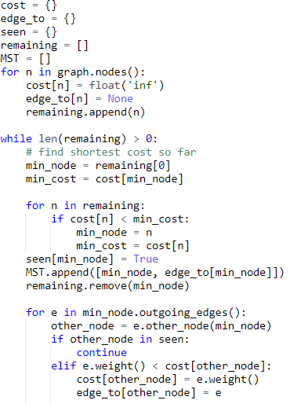
Prim’s (linear search for minimum cost edge)
Time complexity:
O(V²)

Slide 10
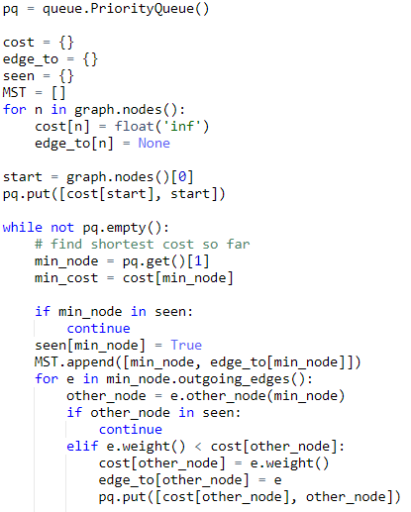
Prim’s (priority queue for minimum cost edge)
Time complexity:
O(E log V)

Slide 11
Prim’s (priority queue for minimum cost edge)
Time complexity:
O(E log V)
In worst case, we would need to iterate through all edges in the graph
Log time to get/put from priority queue
There will only be at most V entries in the pq at any one time though

Slide 12
Prim’s (priority queue for minimum cost edge)
Time complexity:
O(E log V)
In worst case, we would need to iterate through all edges in the graph
Log time to get/put from priority queue
There will only be at most V entries in the pq at any one time though

Slide 13
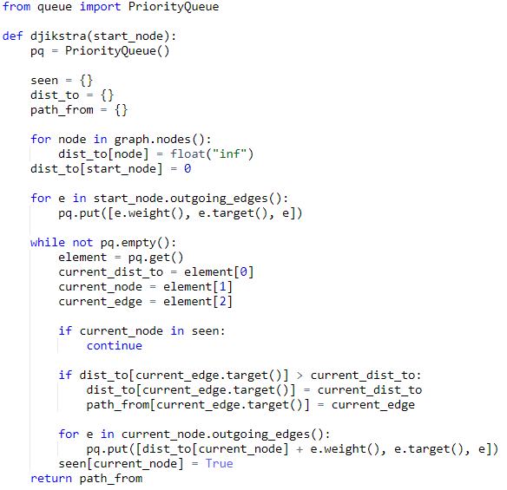
Djikstra’s
Time complexity:
O(E log V)
In worst case, we would need to iterate through all edges in the graph
Log time to get/put from priority queue
There will only be at most V entries in the pq at any one time though

Slide 14
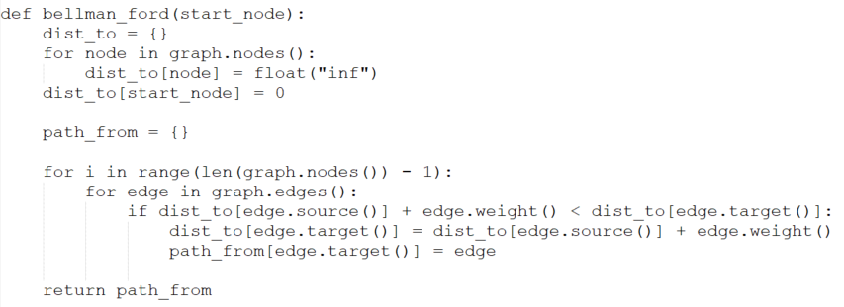
Bellman Ford
Time complexity:
O(VE)

Slide 15
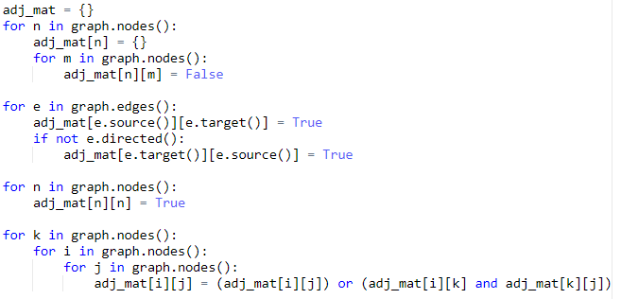
Floyd-Warshall Transitive Closure
Time complexity:
O(V³)

Slide 16
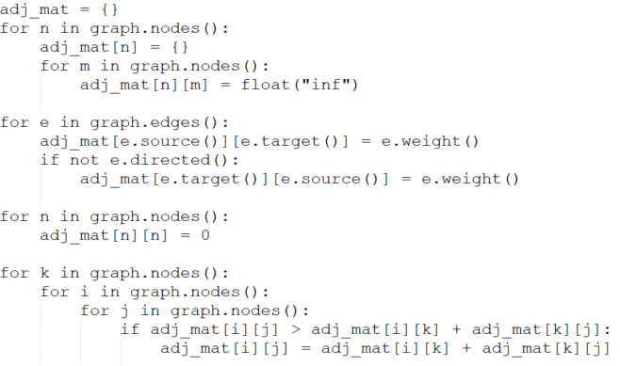
Floyd-Warshall All-Pairs Shortest Path
Time complexity:
O(V³)

Slide 17
Checking for negative cycles
Bellman-Ford
Run bellman-ford
Continue for 1 more iteration
If any of the path costs change in the extra iteration, there is a negative cycle
Floyd-Warshall
Run Floyd-Warshall
Check diagonals (where start and end nodes are the same)
If there are any non-zero path costs, there is a cycle

Slide 18
Calculating Width of a Graph
Run Floyd-Warshall (all-pairs shortest path)
Find the maximum path cost
This will be the width of the graph (the maximum-of-the-minimum cost between any pair of nodes)

